Slide 1
ROSEBANK INTERNATIONAL COLLEGE • WORK INTEGRATED LEARNING 1
Next Level Gaming & Esports Arena Website
Module: XHAW5112 | Submission Date: November 13, 2026
Project Team Members
ACADEMIC DETAILS
Student Name | Student Number
Mulenga Noam | ST10517736
Cain Joseph | ST10541995
Neo Sipho | ST10535603
Umile Mbombela | ST10524342
Institution: ROSEBANK INTERNATIONAL COLLEGE
Programme: WORK INTEGRATED LEARNING 1
Module Code: XHAW5112
Submitted: November 13, 2026

Slide 2
BRAND & ARCHITECTURE
Consistent Visual Identity & Pages
Unified Brand Palette
5 Core Navigation Pages
Interactive Booking Flow
Deep cobalt blue, vibrant lime green, crisp white grounds.
Home, Experiences, The Arena, Packages, and Contact.
Real-time session estimator and instant modal enquiry form.

Slide 3
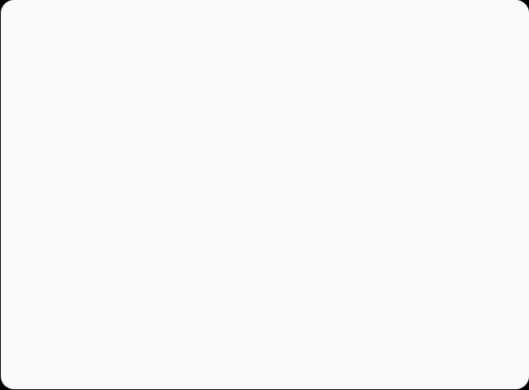
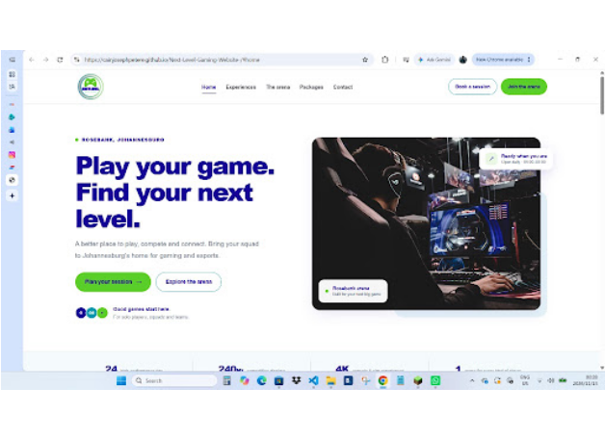
PAGE 01 • HOME
Hero Landing & Arena Introduction
Play your game. Find your next level.
Rosebank Location: Johannesburg's premier hub for gaming and esports.
Clear Call-to-Actions: Direct triggers to plan sessions or explore.
Operating Hours: Live availability badge open daily 09:00–00:00.

Slide 4
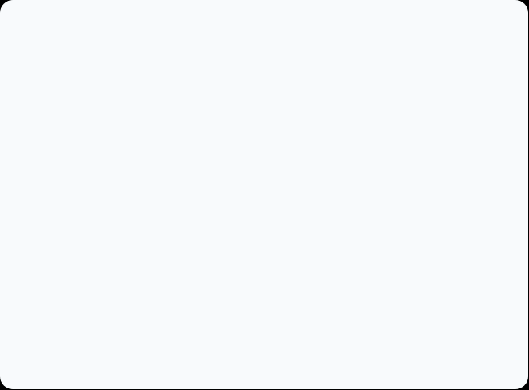
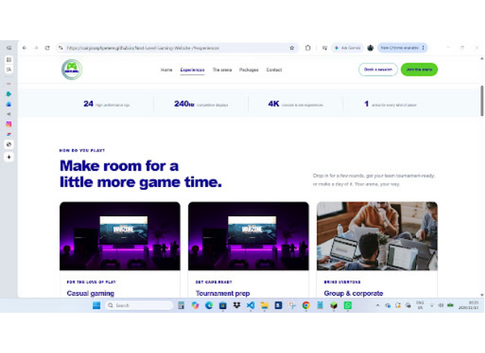
PAGE 02 • EXPERIENCES
Hardware Specs & Play Modes
Make room for a little more game time.
Key Arena Metrics: 24 rigs, 240Hz displays, 4K console zones.
Tailored Play Categories: Casual gaming, tournament prep, corporate events.
Visual Card Layout: High-contrast dark gaming photography with bold headers.

Slide 5
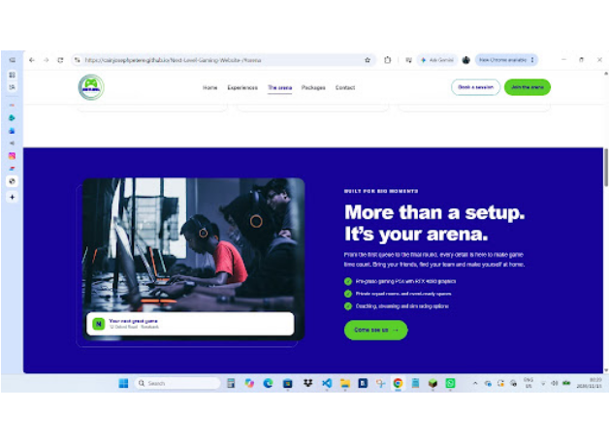
PAGE 03 • THE ARENA
Pro-Grade Facilities & Squad Rooms
More than a setup. It's your arena.
RTX 4080 Graphics: Pro-grade gaming PCs built for competitive play.
Private Squad Spaces: Dedicated team rooms and event-ready zones.
Specialty Services: Live streaming booths, coaching, sim racing rigs.

Slide 6
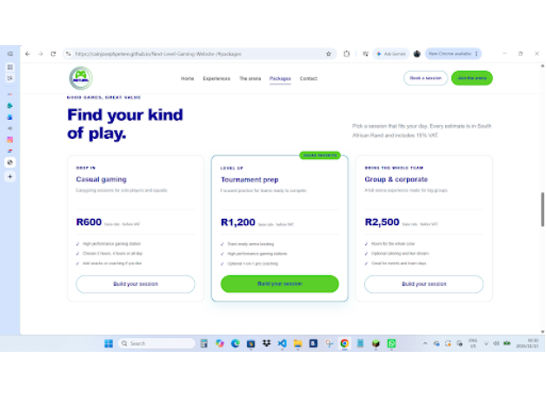
PAGE 04 • PACKAGES
Transparent South African Rand Pricing
Find your kind of play.
Casual Gaming (R600): Flexible 2-hour, 4-hour, or full-day passes.
Tournament Prep (R1,200): Squad-favorite tier with optional pro coaching.
Group & Corporate (R2,500): Full-arena booking with catering and streaming.

Slide 7
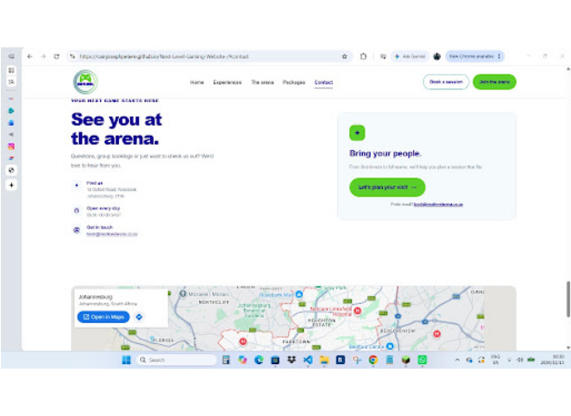
PAGE 05 • CONTACT
Venue Location, Hours & Map
See you at the arena.
Physical Address: 12 Oxford Road, Rosebank, Johannesburg, 2196.
Direct Contact: book@nextlevelarena.co.za with embedded Google Maps.
Group Enquiries: Dedicated prompt for custom team sessions.

Slide 8
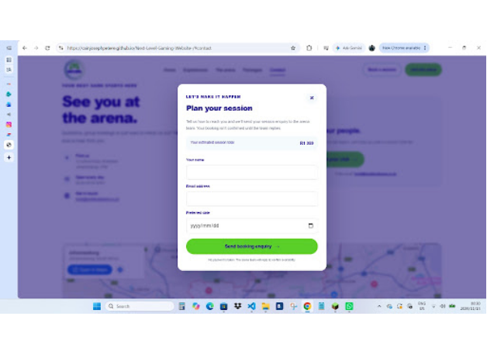
INTERACTIVE FEATURE • BOOKING MODAL
Dynamic Session Planner & Enquiry
Plan your session in seconds.
Live Cost Calculation: Displays estimated session total including 15% VAT.
Streamlined Inputs: Captures name, email address, and preferred date.
Zero Upfront Payment: Sends enquiry directly to the arena team.

Slide 9
PLATFORM HIGHLIGHTS
Key Arena Specifications & Rates
24
240Hz
R600
15 hrs
RTX 4080 Gaming Rigs
Competitive Displays
Starting Base Rate
Daily Open Window

Slide 10
ROSEBANK INTERNATIONAL COLLEGE • XHAW5112
Thank You & Questions
Next Level Gaming & Esports Arena Website — Presented by Mulenga Noam, Cain Joseph, Neo Sipho & Umile Mbombela

